Slide 1
Upset Potential in the National Football League (NFL)
Mary J. Snyder
Advisor: Michael P. McGuire Ph.D.

Slide 2
Agenda
Introduction
Dataset
Experiment Design, Tools, & Approaches
Results
Conclusion

Slide 3
Introduction
Background
Abstract
Determining factors that influence the potential for upsets in the NFL
Objectives
Fun applications
Fantasy Football
Spread or confidence point picks leagues
Teams preparation
Take steps to protect themselves
Focus their training to upset other teams

Slide 4
Dataset
Data attribute selection
Game information
Team, score, outcome, week
Statistics related
Injuries, average points for, average points against
Outside influence
Weather, time zone, time of games, number of days rest between games
Challenges
Injuries per position
Weather
Game time
Sources
Historical databases, NFL.com, weather databases

Slide 5
Experiment Design, Tools, & Approaches
Data Analysis
Preprocessing: Binning
Pairs, Scatterplots, Histograms
Magnitude of Upset
Clustering
DBSCAN, K-means
Classification
Decision Tree, Naïve Bayes
Upset
Classification
Decision Tree, Naïve Bayes
Holdout method - 70/30 split
Past years to predict current year

Slide 6
Results
<insert results here>

Slide 7
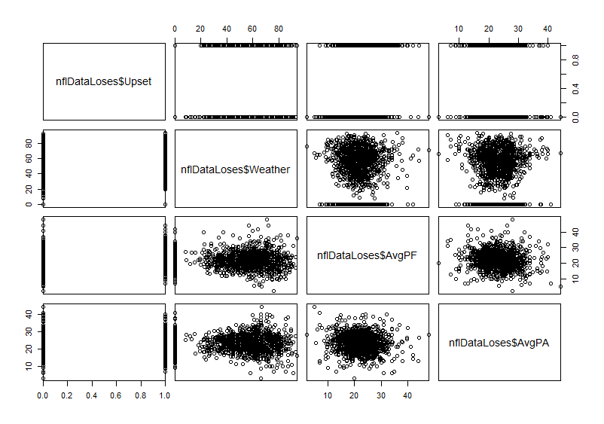
Results: Data Analysis (x of X)

Slide 8
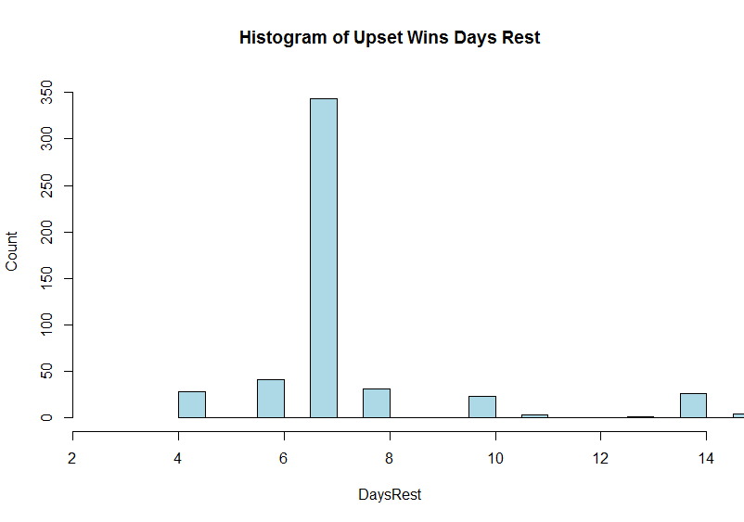
Results: Data Analysis (x of X)

Slide 9
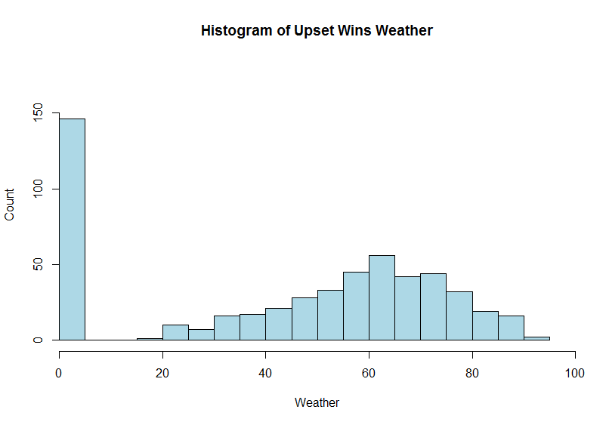
Results: Data Analysis (x of X)

Slide 10
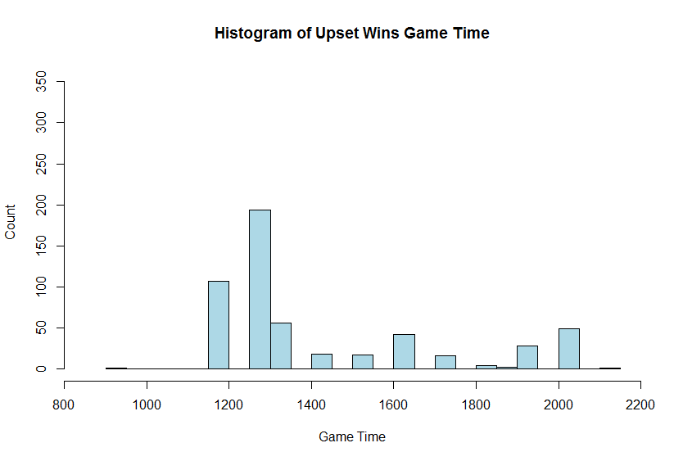
Results: Data Analysis (x of X)

Slide 11
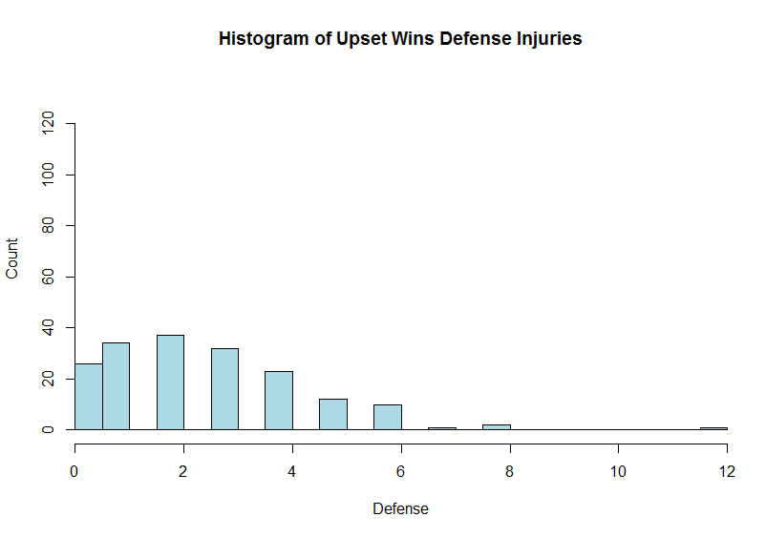
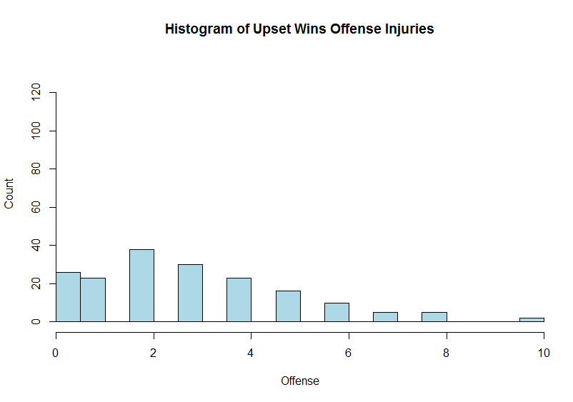
Results: Data Analysis (x of X)

Slide 12
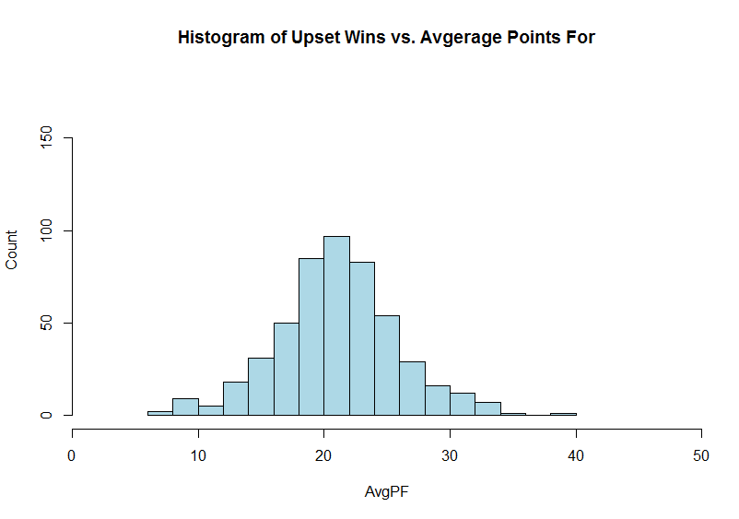
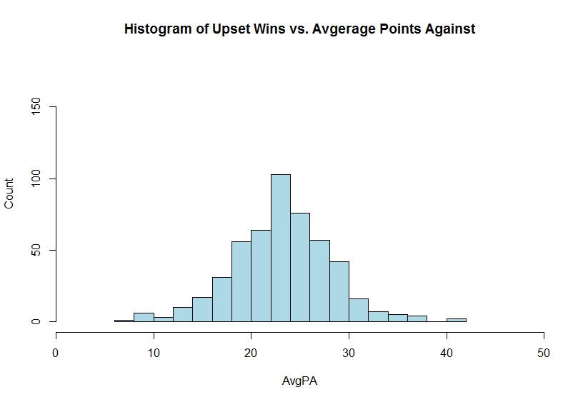
Results: Data Analysis (x of X)

Slide 13
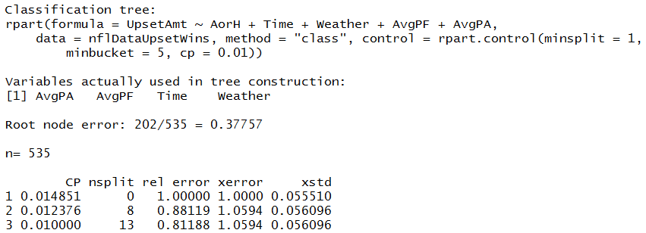
Results: Data Analysis (x of X)

Slide 14
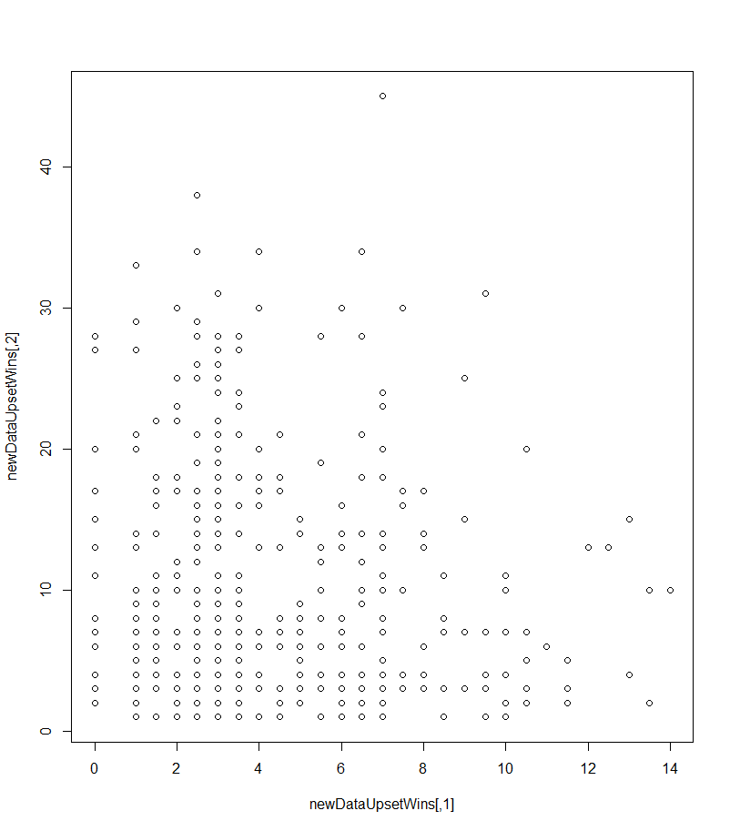
Results: Upset Amount – Clustering (x of X)

Slide 15
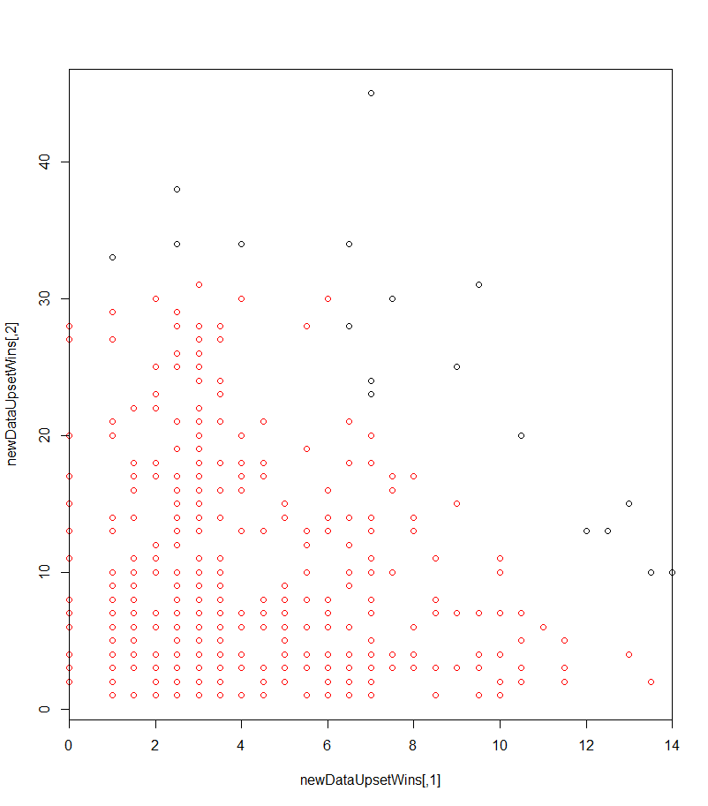
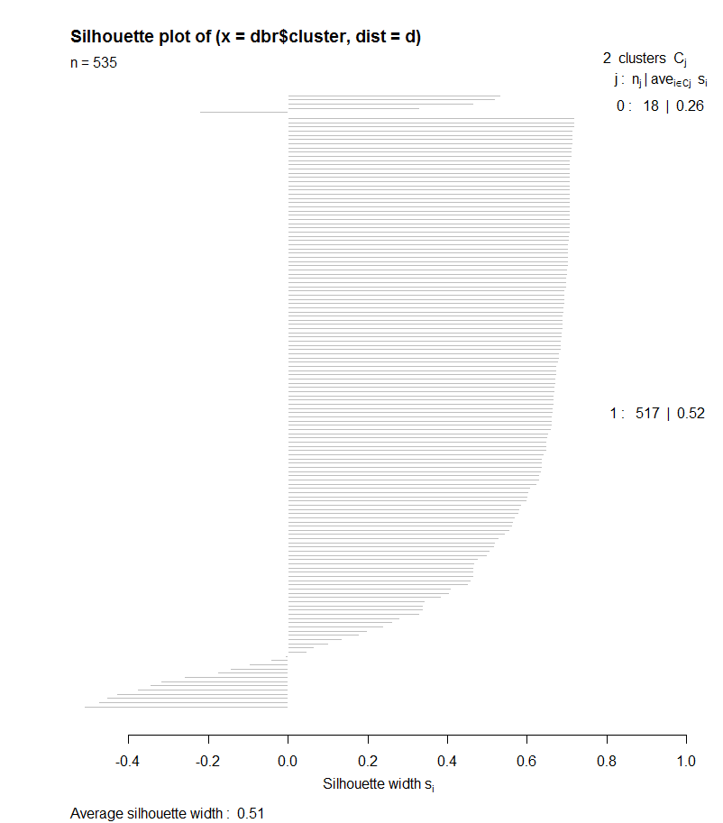
Results: Upset Amount – Clustering with DBSCAN (x of X)

Slide 16
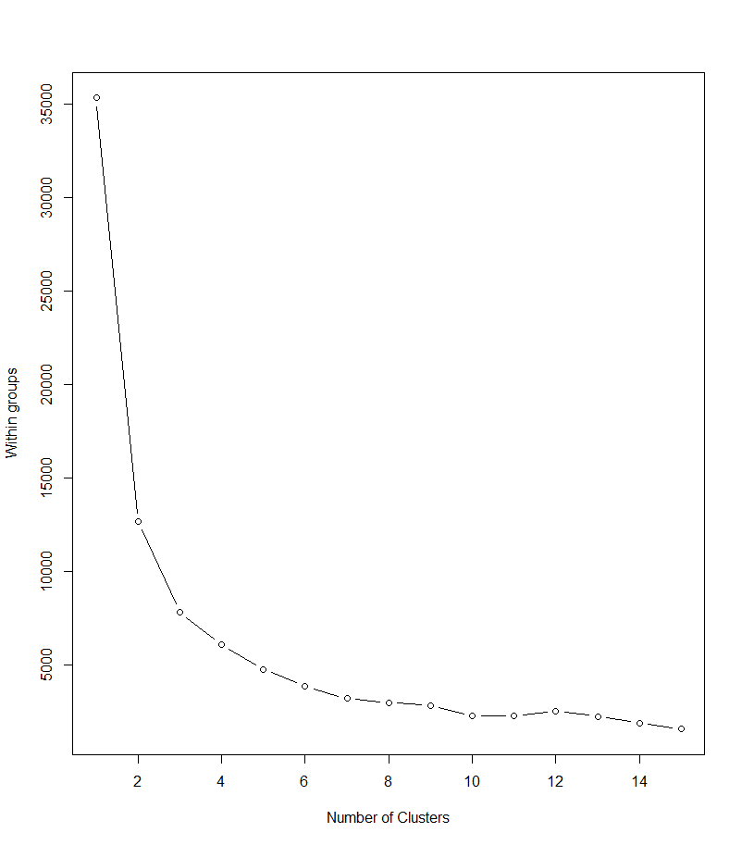
Results: Upset Amount – Clustering with K-means (x of X)

Slide 17
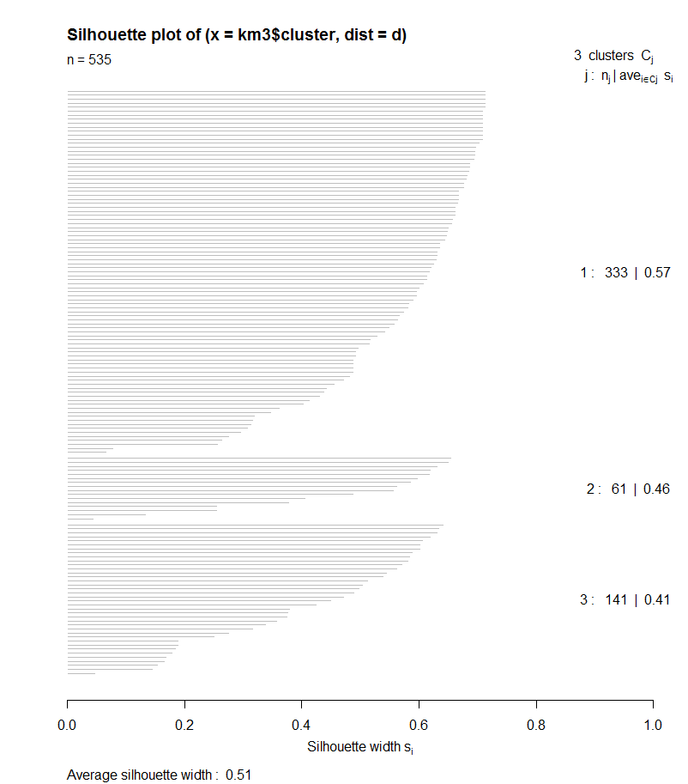
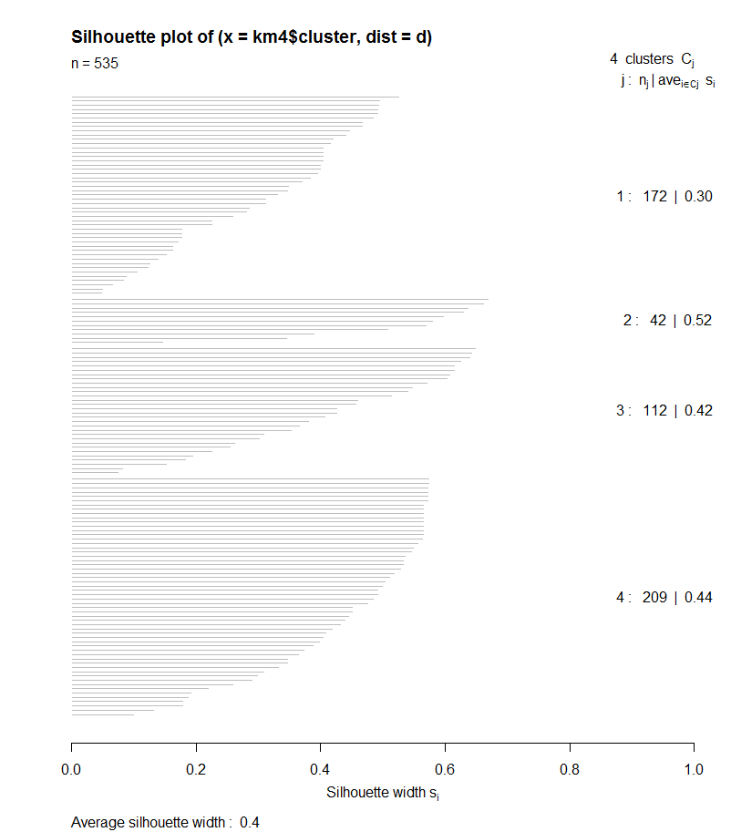
Results: Upset Amount – Clustering with K-means (x of X)
K-means cluster k=3
K-means cluster k=4

Slide 18
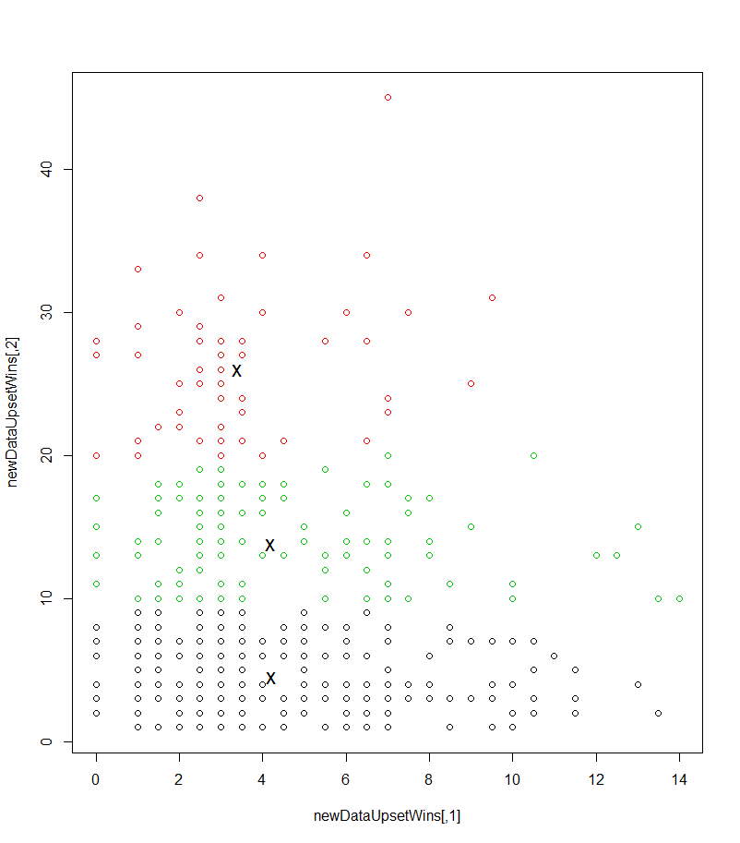
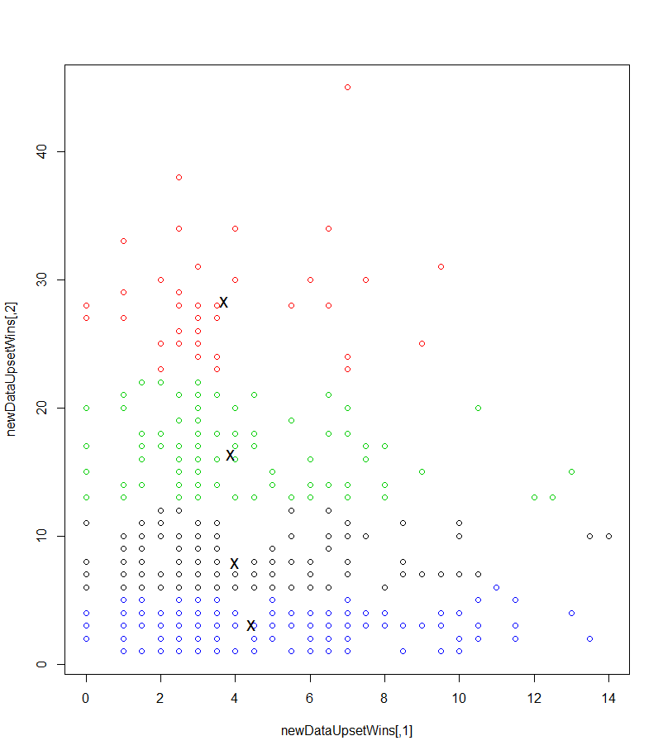
Results: Upset Amount – Clustering with K-means (x of X)
K-means cluster k=3
K-means cluster k=4

Slide 19
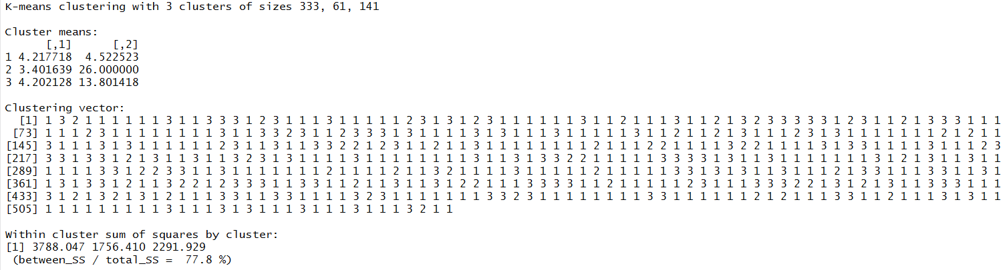
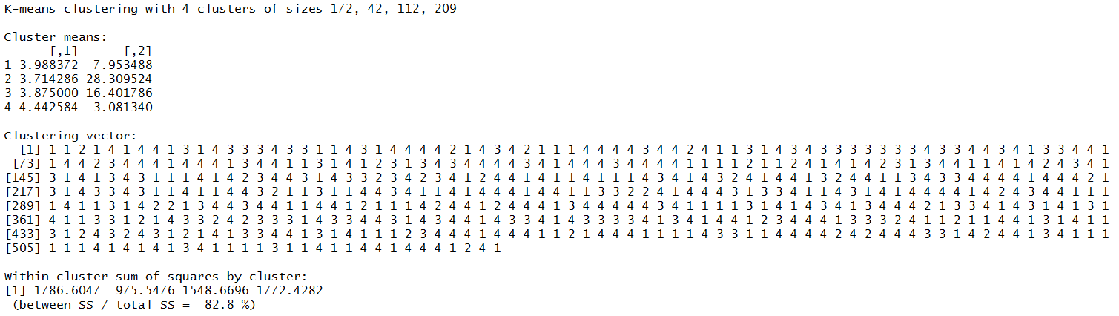
Results: Upset Amount – Clustering with K-means (x of X)
K-means cluster k=3
K-means cluster k=4

Slide 20
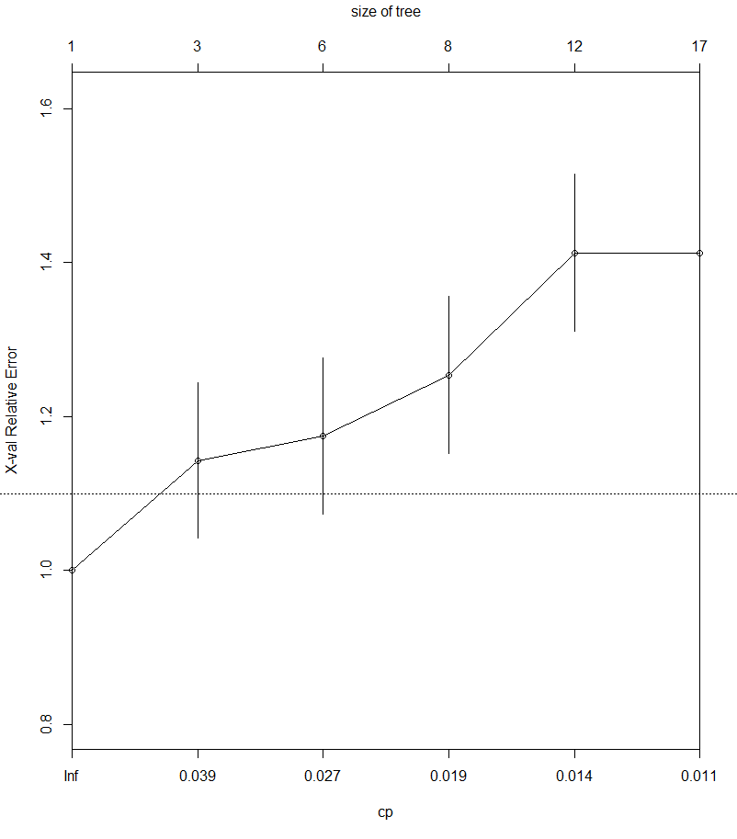
Results: Upset Amount – Classification with Decision Tree (x of X)

Slide 21
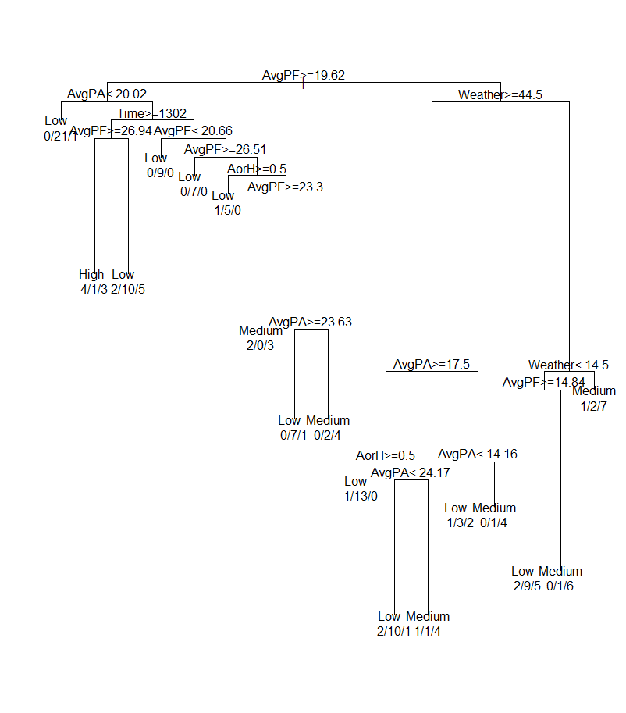
Results: Upset Amount – Classification with Decision Tree (x of X)

Slide 22
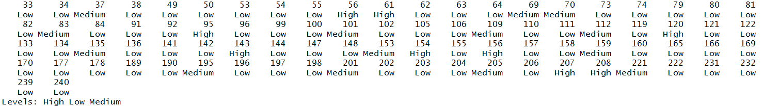

Results: Upset Amount – Classification with Decision Tree (x of X)

Slide 23
Results: Upset Amount – Classification with Naïve Bayes (x of X)

Slide 24
Results: Upset Amount – Classification with Naïve Bayes (x of X)

Slide 25
Conclusion
<insert conclusions here>

Slide 26
Question
<insert here>

